Slide 1
Course Outline
Processor Architecture, Caches, Instruction-Level Parallelism, Superscalar & VLIW architecture
Multithreading, Multi-core processors, Cache Coherence and Memory Consistency; Multi-core Cache Organization
Virtual Memory System
Memory, DRAM Architecture
Performance Evaluation
Data-level Parallelism and Accelerators
Power management
Datacenter architecture
Architecture Support for System Security

Slide 2
Grading
1 Mid-Term Test = 20 marks
3 Assignment = 3x10 marks
1 Programming exercise
2 Written assignments (problem solving/term paper)
1 Term Project = 20 marks [Group of 2]
1 Final Exam = 30 marks
Text: Hennessy and Patterson, “Computer Architecture: A Quantitative Approach”:
6th Ed. (Available in Indian Edition!)
A large part of it would be assumed as reading exercise!

Slide 3
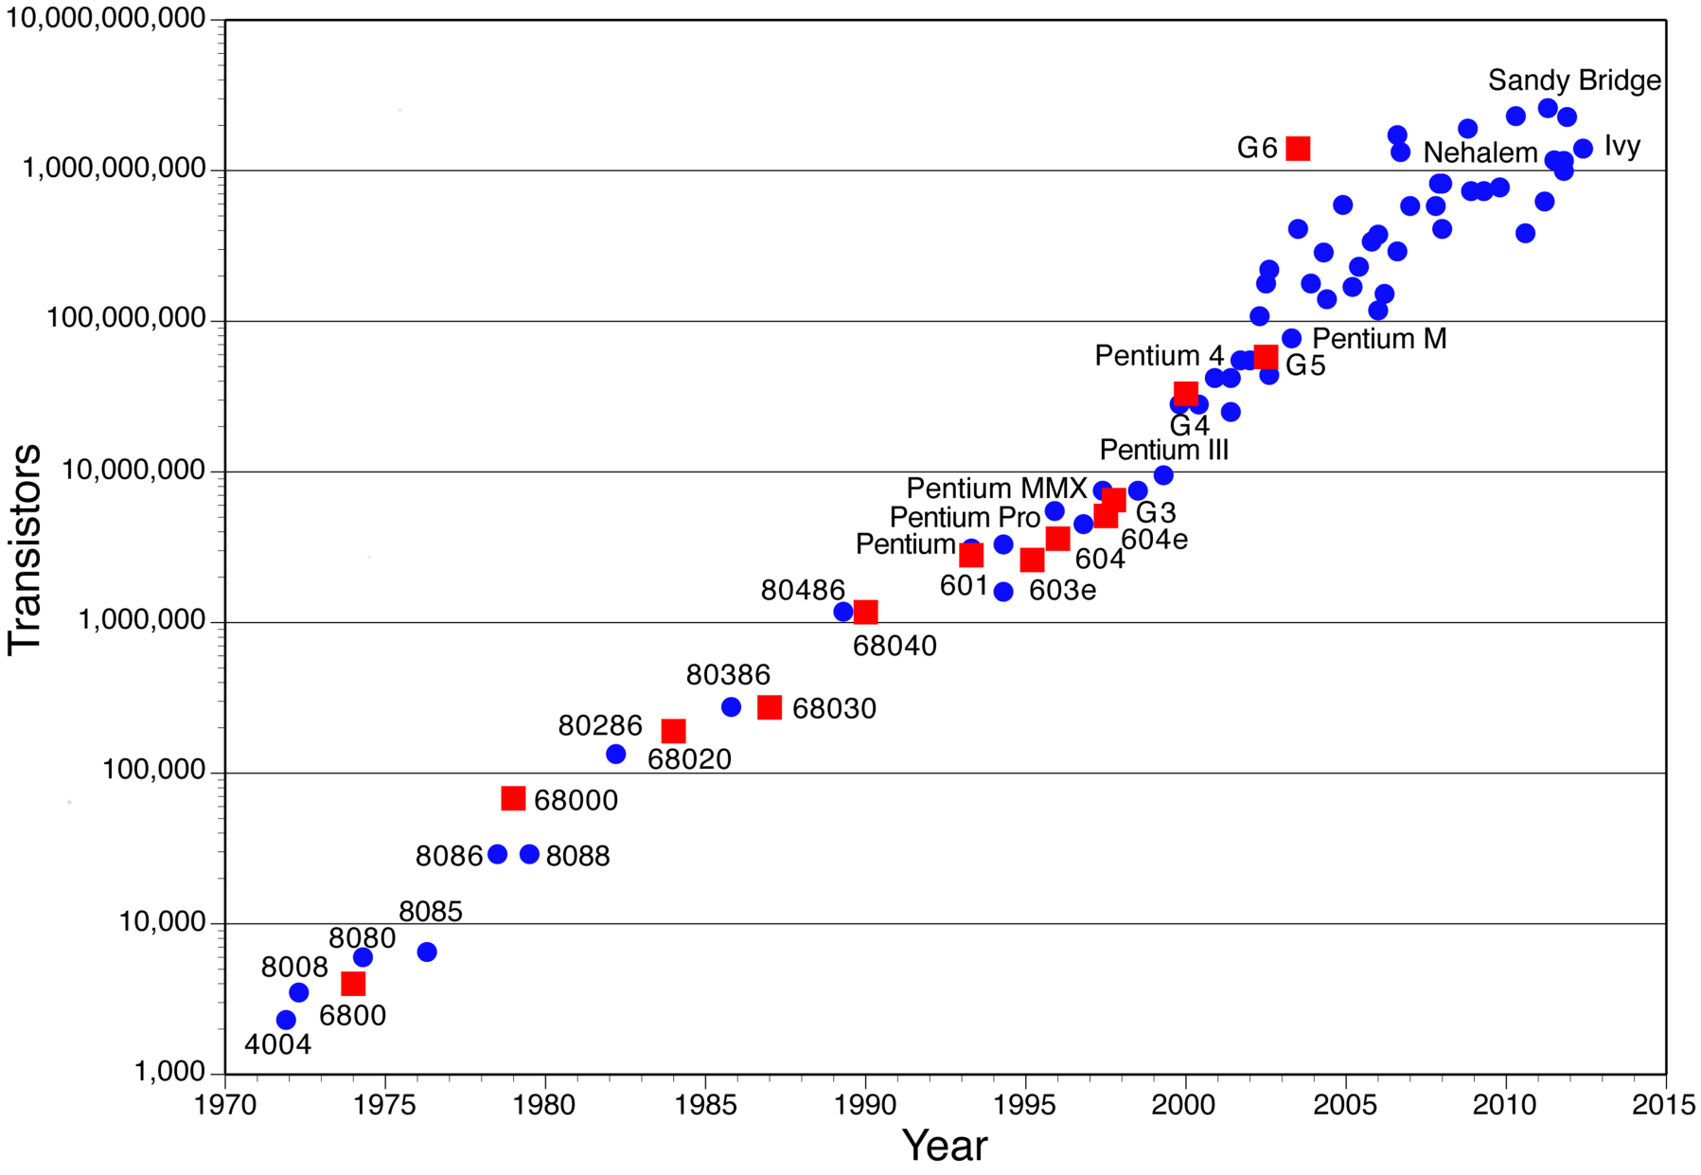
Moore’s Law
No. of Transistors doubles every 18 months

Slide 4
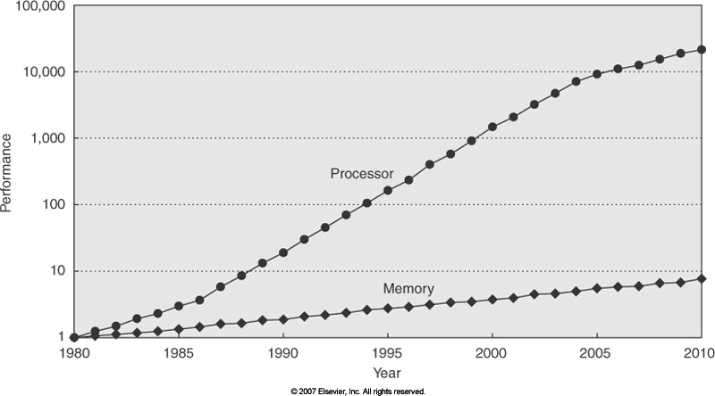
Moore’s Law : Other Implications

Slide 5
Amdahl’s Law
Speedup is limited by the part of the program which doesn’t benefit by an enhancement
Sp = = , for large k
1
1
s + (1-s)/k
s
Example 1 : s = 0.5, k = 100, Sp = 1.81
Maximum Speedup is 2!
Example 2: s = 0.1, k = 10, Sp = 5.26.
Moral : Make the common case faster!

Slide 6
Pipelining : Review
0
1
2
3
4
Time
5
i
IF
ID
EX
MEM
WB
i +1
IF
ID
EX
MEM
WB
IF
ID
EX
MEM
WB
i +2
IF
ID
EX
MEM
WB
i +3
Instrn.
Exec. Time of instrn. still 5 cycles, but throughput, now is 1 instrn. per cycle.
Initial pipeline fill time (4 cycles), after which 1 instrn. completes every cycle

Slide 7
Pipelined Processor Datapath
4
Zero?
+
Data
Mem.
Reg.
File
ALU
PC
Ins.
Mem.
IF/ID
ID/EX
MEM/WB
EX/MEM
sign
extend
Instrn. Fetch
Instrn. Decode
Execution
Memory
WB

Slide 8
Pipeline Hazards
Hazards prevent next instruction from executing during its designated clock cycle
Structural hazards: Happen due to simultaneous request for the same resource by 2 or more instrns. (e.g., IF and MEM both require memory port!)
Data hazards: Instruction depends on result of prior instruction still in the pipeline.
Control hazards: Due to branch and jump instrns. Next PC (target PC) available only after 3 cycles (in EX stage) while IF has to take place in the next cycle!

Slide 9
Structural Hazard
Assume a single memory port
i
IF
ID
EX
MEM
WB
ld R3, 8(R2)
i + 1
IF
ID
EX
MEM
WB
i + 2
IF
ID
EX
MEM
WB
MEM and IF req. memory port
i + 3
B
B
B
B
B
IF
i + 3
IF
ID
EX
MEM
WB

Slide 10
Data Dependence
True data dependency (RAW)
Anti dependency -- write-after-read (WAR)
Output dependency -- write-after-write (WAW)
Example:
r3 <-- r7
r8 <-- load (r3)
r3 <-- r3 + 4
RAW
WAW
WAR

Slide 11
Data Hazard
0
1
2
3
4
Time
5
i
IF
ID
EX
MEM
WB
add R3 ← R1, R2
i + 1
IF
B
B
B
B
ID
EX
MEM
WB
sub R4 ← R3, R8
i + 1
B
B
B
B
ID
EX
MEM
WB
i + 1
ID
EX
MEM
WB

Slide 12
Data Hazard Solutions
Interlock: Hardware detect data dependency and stalls dependent instrns.
Byepassing or Forwarding: Computed data forwarded as soon as available (from EX or MEM stage)

Slide 13
Data Hazard Solutions (contd.)
Forwarding or Bypassing : forward the result as soon as available (EX or MEM stage) to EX.
add R3 ← R1, R2
IF
ID
EX
MEM
WB
sub R5 ← R3, R4
IF
ID
EX
MEM
or R7 ← R3, R6
IF
ID
EX

Slide 14
Processor Datapath for Forwarding
Zero?
Data
Mem.
NPC
A
ALU
B
Imm
Execution
Memory

Slide 15
Data Hazard Solutions
Interlock: Hardware detect data dependency and stalls dependent instrns.
Byepassing or Forwarding: Computed data forwarded as soon as available (from EX or MEM stage)
For what Ops from MEM stage?
Can byepassing avoid all stalls?

Slide 16
Forwarding may not always Work!
ld R3 ← M(R1)
IF
ID
EX
MEM
WB
sub R5 ← R3, R4
IF
ID
EX
MEM
or R7 ← R3, R6
IF
ID
EX
Forwarding cannot eliminate all stalls in deep pipelines!

Slide 17
Data Hazard Solutions
Interlock: Hardware detect data dependency and stalls dependent instrns.
Byepassing or Forwarding: Computed data forwarded as soon as available (from EX or MEM stage)
For what Ops from MEM stage?
Can byepassing avoid all stalls?
Instruction Scheduling: Reorder instrns. such that dependent instrns. are 2-3 cycles apart.
Static Instruction Scheduling
Dynamic Instruction Scheduling

Slide 18
Control Hazard
Cond. & target resolved here
beqz R3, out
IF
ID
EX
MEM
WB
Fetch instrn. (i +1) or from target?
B
B
B
B
IF
ID
EX
MEM
B
Fetch instrn. (i +1) or from target?
B
B
B
B
IF
ID
EX
Branch resolved Fetch appropriate instrn.
IF
ID

Slide 19
Pipelined MIPS Datapath
4
Adder
Zero?
+
Data
Mem.
Reg.
File
ALU
PC
Ins.
Mem.
IF/ID
ID/EX
MEM/WB
EX/MEM
sign
extend
Instrn. Fetch
Instrn. Decode
Execution
Memory
WB

Slide 20
Control Hazard Solutions
Static Branch prediction policies:
Static Not-Taken policy:
Fetch instrn. from PC + 4 even for a branch instrn.
Squash the fetched instrn, and re-fetch from branch target address
Delayed Branching:
microarchitecture designed such that branch (control transfer) takes place after a few following instructions.
add R3 <-- R2, R4
add R3 <-- R2, R4
beq R1, out
nop
(delay slot instrn.)

Slide 21
Delayed Branching
Instrns. that do not affect the branching condition can be used in the delay slot.
Where to get instrns. for filling delay slots?
Instrns. Before the branch
Instrns. from the target address
Instrns. from fall through
Cancelling delayed branches, which squash the instrn. in the delayed when the branch is taken (or not taken) -- facilitate more slots to be filled.

Slide 22
Dynamic Branch Prediction
For the same static branch instrn. prediction for different instances may be different.
Using the history of branches to predict the branch outcome (taken or not-taken)
1-bit predictors
2-bit predictors
2-level correlated predictors
path-based predictors, …

Slide 23
Simple 1-bit Branch Prediction
Store previous history of a branch -- taken or not-taken (1-bit) in Branch Prediction Buffer
Least Significant bits of PC used to index BPB.
Update Predict bit after branch is resolved.
Predict branch outcome only, not target address.
Influence of other (static) branches which have same LS bits (alias)
0
0 → Not taken
1 → Taken
PC
BPB (2048 entries)
1-bit prediction will mispredict twice on every loop.

Slide 24
2-bit Branch Prediction
State of each static branch represented by 2-bits.
Implement the State machine
Different state transition diagram for diff. 2-bit schemes.
Implementation using saturating counters ?
Gives high prediction accuracy 85% to 95%.
Taken
Not-Taken
ST
WT
Taken
Not-Taken
Taken
Not-Taken
WNT
SNT
0
Taken
Not-Taken

Slide 25
2-bit Prediction
What is the benefit of 2-bit over 1-bit?
00, 01 → Not taken
10, 11 → Taken
L1: R2 ← 100
…
L2: R1, ← 100
…
R1 ← R1 - 1
b1: bne R1, L2
R2 ← R2 - 1
b2: bne R2, L1
10
PC
BPB (2048 entries)
Still no prediction of target address!
With a 2-bit prediction the no. of mispredictions of branch b1 is lower!

Slide 26
Branch Target Buffer
Store branch target address (computed when the static branch instrn. is encountered first) along with prediction bits -- Branch Target Buffer.
Associate tag bits to avoid other (branch) instrns. influence the prediction.
When to make the prediction?
Prediction can be made in IF stage itself! no stall on correct prediction.
Size of BTB = 2048x52 !
PC
00
V
Tag
Target Addr.
=
Yes: Predict
No: Don’t Predict

Slide 27
Other Branch Prediction Schemes
Correlated Prediction
Path Prediction
A
A
B
C
B
C
D is taken if A is not taken
D
D
E
E
F
F
G

Slide 28
2-Level Branch Prediction
2-bit scheme uses the history of the same static branch for prediction.
In practice, history of other branches also influence branching.
if (aa == 2) aa = 0;
if (bb != 2) bb = 0;
if (aa == 0) || (bb == 0) { …
history | br1 | 1 | 1 | 0 | 0
 | br2 | 1 | 0 | 1 | 0
Pred. | br3 | 1 | 1 | 1 | ?

Slide 29
2-Level Prediction (contd.)
Branch history register/table to maintain the outcome of previous (dynamic) k branches.
Pattern History table(s) to record the branch behavior (2-bit FSM).
Branch history can be global or local
Pattern history can be global or local.
Other variations (g-share, p-share)
Results upto 98% prediction accuracy.
Reading:
TseYu Yeh and Yale N Patt, “Alternative Implementations of TwoLevel Adaptive Branch Prediction”, ISCA 92

Slide 30
GAg and GAp Schemes
Global branch history register & global pattern history table
Global branch history reg. and per addr. pattern history table
BHR (k-bit)
0/1
PC
BHR (k-bit)
Pred.
Pred.
PHT (2^{k} entries)
PPHT (2^{k} x 2^{m})

Slide 31
PAp Scheme
PC
n-bits
m-bits
PBHT (2^{m} k-bit entries)
PPHT (2^{k} x 2^{n})

Slide 32
Comparison of 2-Level Schemes
In GAg, 1st-level history is based on last k dynamic branches.
No per-addr. Branch or pattern history.
History of all branches influence prediction.
In GAp, correlation of other branches, and past behavior of this branch influence prediction.
In PAg, per-addr. branch history is maintained.
History of a branch influence its prediction; but same pattern behavior for all branches
PAp other branches influence is least.
Per-Set schemes use addr., opcode type, etc. to determine sets.

Slide 33
G-Share and Other Predictors
G-share is similar to GAg, except that BHR is XORed with PC to index in PHT.
Eliminates interference of same branch history across different branches.
2-Level predictors have longer warm-up time to build history. Frequent context-switching affects building the history.
Hybrid predictors take advantage of multiple predictors.
Path-based schemes using history of target addresses of branches and not their outcomes.

Slide 34
Hybrid Predictors
Global predictor: Has 4K entries and is indexed by the history of the last 12 branches; each entry in the global predictor is a standard 2-bit predictor
Local predictor: Consists of a 2-level predictor:
Top level a local history table consisting of 1024 10-bit entries; each 10-bit entry corresponds to the most recent 10 branch outcomes for the entry.
Next level Selected entry from the local history table is used to index a table of 1K entries consisting a 3-bit saturating counters, which provide the local prediction
4K 2-bit counters to choose between the global predictor and local predictor
Total size: 4K*2 + 4K*2 + 1K*10 + 1K*3 = 29K bits!
(~180,000 transistors)

Slide 35
Tournament Predictor in 21264
Local Pred.
BHR
PC
2
3
GlobalPred.
PHT
PBHT
Meta Pred.
Pred.

Slide 36
Indirect Branches
Branches or jumps whose target addr. varies at runtime.
Function return, jumps for implementing case statements, etc.
Target address prediction for function returns using a return address stack of size 8 to 16.

